Slide 1
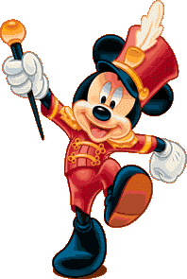
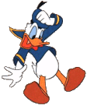
Animation

Slide 2
Outline
Principles of Traditional Animation Applied to Computer Animation (Lasseter, 1987)
Animation: Can it facilitate? (Tversky and Morrison, 2002)
On Creating Animated Presentations (Zongker and Salesin, 2003)

Slide 3
Overview: Traditional Animation
Early 2D Animation: Used traditional techniques
Early 3D Animation: Neglected traditional techniques.
Understanding the 11 Fundamental principles of traditional animation techniques is essential to producing good computer animation.

Slide 4
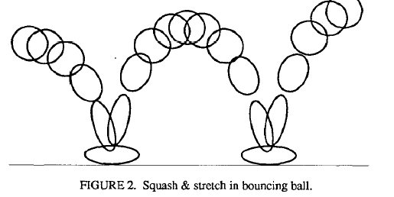
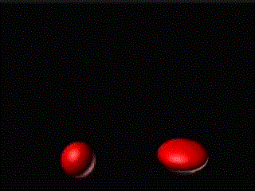
1. Squash and Stretch
Teaches basic mechanics of animation.
Defines rigidity of material.
Important in facial animation.

Slide 5
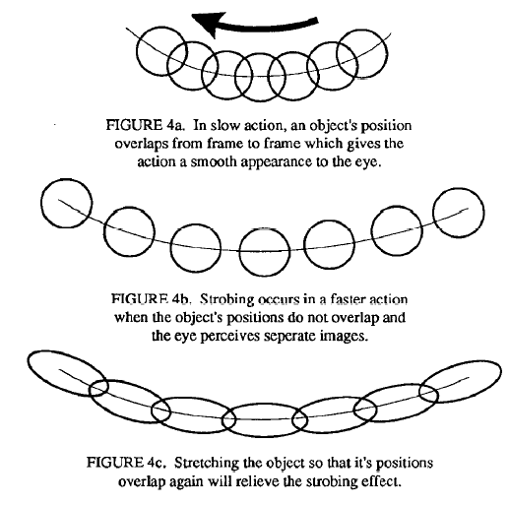
Squash and Stretch Cont.
Can relieve the disturbing effect of strobing.

Slide 6
2. Timing and Motion
Gives meaning to movement.
Proper timing is critical to making ideas readable.
Examples:
Timing: tiny characters move quicker than larger ones.
Motion: can define weights of objects.

Slide 7
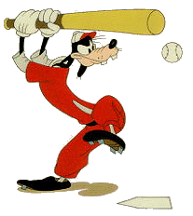
3. Anticipation
Preparation for an action
Example:
Goofy prepares to hit a baseball.

Slide 8
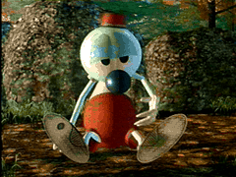
4. Staging
A clear presentation of an idea.
Some Techniques:
Use motion in a still scene or use of static movement in a busy scene.
Use of silhouettes (to the side)

Slide 9
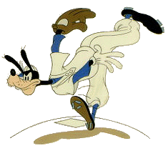

5. Follow Through and Overlapping Action
1. Follow Through
Termination part of an action.
Example: after throwing a ball
2. Overlapping Action
Starting a second action before the first has completed.
Example: Luxo Jr.’s hop with overlapping action on chord.

Slide 10
6. Straight Ahead Action and Pose-to-Pose Action
1. Straight Ahead
Animator start from first drawing in the scene and draw all subsequent frames until the end of scene.
2. Pose-to-Pose
Animator plans actions, draws a sequence of poses, in between frames etc.

Slide 11
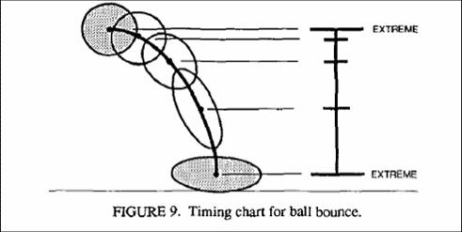
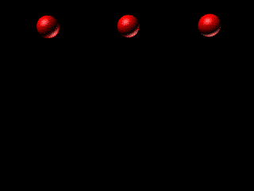
7. Slow in and Out
Spacing of inbetween frames to achieve subtlety of timing and movement.
3d keyframe comp. Systems uses spline interpolation to control the path of an object.
Has tendency to overshoot at extremes (small # of frames).

Slide 12
8. Arcs
Visual path of action for natural movement.
Makes animation much smoother and less stiff than a straight line.

Slide 13
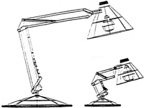
9. Exaggeration
Accentuating the essence of an idea via the design and the action.
Needs to be used carefully.
Example: Luxo Jr. made smaller to give idea of a child.

Slide 14
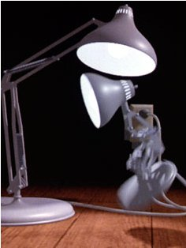
10. Secondary Action
Action that results directly from another action.
Used to increase the complexity and interest of a scene.
Example:
Body movement is the primary action, facial expression is the secondary action

Slide 15
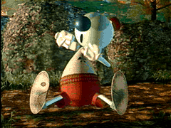
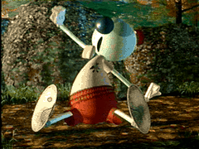
11. Appeal
Refers to what an audience would like to see.
Character cannot be too simple (boring) or too complex.
Examples:
Avoid mirror symmetry, assymmetry is interesting.

Slide 16
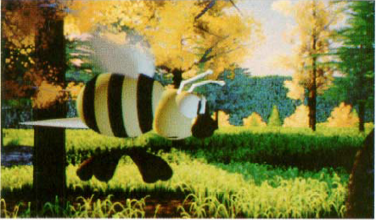
What techniques used for Wally B.?

Slide 17
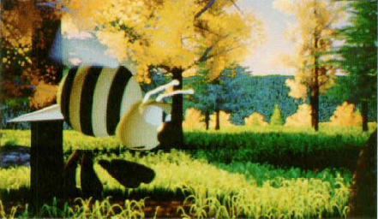
What do you think Wally B’s going to do?

Slide 18
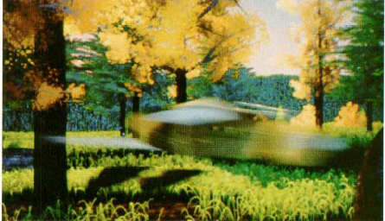
The Action: Zooooooooooommmm!

Slide 19
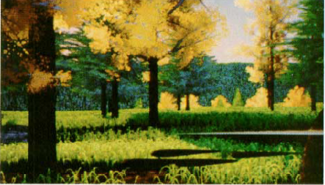
Termination: Poof! He’s gone!

Slide 20
Role of Personality
Animator’s first goal is to entertain.
Success of animation lies in the personality of the characters.
Conclusion
Hardware/Software are simply not enough, these principles are just as important tools too.

Slide 21
Outline
Principles of Traditional Animation Applied to Computer Animation.
Animation: Can it facilitate?
On Creating Animated Presentations

Slide 22
Overview
Graphics have many advantages.
What makes graphics effective ?
1. Congruence Principle
2. Apprehension Principle
Can Animation facilitate?

Slide 23
Advantage Graphics
Help in communication.
May save words by showing things that would otherwise need many.
Externalize internal knowledge
I. Reduces the burden on memory and processing by off-loading.
II. Makes underlying structures and processes transparent.
4. Used carefully can facilitate comprehension, learning, memory, communication and inference
Graphics are not always effective. (text vs graphics)

Slide 24
Criteria 1:
Congruence Principle
The structure and content of the external representation should correspond to the desired structure and content of the internal representation.

Slide 25
Animation
By Congruence Principle: should be natural way for conveying concepts of change, just as space in graphics is a natural for conveying actual space.
Appear to be effective for expressing processes ie. Weather patterns, circuit diagrams, or circulatory systems etc.
Compelling and attractive

Slide 26
Evaluating Animation
Needs to be compared to graphics that do not change with time, as it is change with time that animation adds.
How well does animation teach complex systems: mechanical, biological, physical, and operational.

Slide 27
Selective Review of Research on Animation

Slide 28
Incomparable Content in Static and Animated Graphics
Examples:
Circulatory system (Large et al., 1996) - animated had blood pathways
Electronic Circuit (Park and Gittelman 1992) - animated showed fine structure.
Pythagorean theorem (Thompson and Riding, 1990) - paper graphic equivalent to discrete animation, but not equivalent to continuous animation.

Slide 29
Incomparable Procedures In Static and Animated Graphics.
Interactivity versus Animation
Prediction versus Animation
Why the confusion?
Success of animation due to advantages of extra information conveyed, rather than animation of the information.
Animation is attractive and exciting.

Slide 30
Criteria 2:
Apprehension Principle
The structure and content of the external representation should be readily and accurately perceived and comprehended.

Slide 31
Why Do Animations Fail?
Animations may be hard to perceive.
Animations may be comprehended discretely.
Not universally preferred and often require expertise for understanding.

Slide 32
Conclusions and Implications
Many apparent successes turn out not to be successes.
Congruence and Apprehension Principles.
Interactivity may be key to overcome animations’ drawbacks.
Animation must be used with care.

Slide 33
Outline
Principles of Traditional Animation Applied to Computer Animation.
Animation: Can it facilitate?
On Creating Animated Presentations

Slide 34
Overview
Microsoft estimates ~30 million ppt presentations are made everyday
Animation could improve them.
PPT is essentially static in nature.
Examine how meaningful animations can be created to improve live presentations.

Slide 35
Authoring Principles for Animations for Presentations
Use parameterization at all levels of the system.
Treat animations as models - animations are treated as parameterized models that have a single parameter: time.
Build slides hierarchically

Slide 36
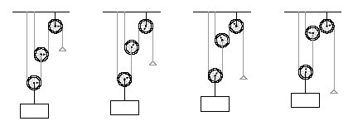
Example of Parameterization

Slide 37


Implemented as a set of libraries in Python.
Users have access to complete, general-purpose programming language.
A collection of drawing objects.

Slide 38
Three Major Drawing Objects
Parameterized diagrams - functions that draw objects and are redrawn each time it is executed.
Animation Objects - One scalar parameter and provides mapping to a set of other drawing objects to be invoked.
Interactive Objects - same as animated objects except can be edited while being played.

Slide 39
Interactive Controllers
Similar to animation script.
Instead of function that creates all of the animation, controller is implemented as a class
Contains set of drawing objects and timelines for controlling their parameters.
Various methods called: edit timelines while animations is being played in response to user input events.

Slide 40
Animation Principles for Presentations
Make all movement meaningful
Avoid instantaneous changes
Reinforce structure with transitions
Create a large virtual canvas
Smoothly expand and compress detail

Slide 41
Animation Principles for Presentations cont.
6. Manage complexity through overlays
Do one thing at a time.
Reinforce animation with narration.
Distinguish dynamics from transitions.

Slide 42
Comparing to Presentation Software
PowerPoint vs Slithy
WYSIWG
Difficult to do complex animations :resort to videos.
Built with animations in mind.
Script to describe animation.
CounterPoint vs Slithy
Focused on using animated navigation between slides to convey the structure of the presentation.

Slide 43
Comparing to Animation Software
Algorithm animation
Alice
Flash
Overall, SLITHY provides much more flexibility and ease for animations for presentations.

Slide 44
Future Work and Conclusion
Still need to find an animated presentation tool that is both very general and easy to use.
Presented ideas provide useful steps at creating and experiencing more informative and exciting presentations.

Slide 45
Animation File Formats
The format used for the animation is entirely based around how complex the animation is, where the animation is designed to be used; such as a webpage, and how large the file is for the animation.
Dynamic HTML
Flash
Shockwave
Animated GIF’s

Slide 46
Dynamic HTML
Is used along side client scripting languages, such as Java Script.
It can be used to create simple animations such as a button and drop down menus. Although a massive downside to using Dynamic HTML is since there are various types of browsers such as Google Chrome and FireFox, information is displayed differently meaning Dynamic HTML may not always be effective

Slide 47
Flash
Animation frame by frame
Can include sound and video
Websites made by flash require high speed internet
Flash also needs a Flash player installed onto the computer in order to show content, although most computers already tend to have this installed.
Flash files (FLA) have to be converted into SWF format before they can be used on the internet.

Slide 48
Shockwave
Used more for 3D graphics and streaming videos
It is designed to work with a Director application, which can then compile various types of assets into a multimedia product, on a much larger scale then Flash.

Slide 49
Animated GIF’s
GIF images which are animated normally have various images combined into a single GIF file.
While GIFs have a limited amount of flexibility and less amount of control compared to other formats, although since it is supported by almost every single web browser, it has become extremely popular. GIF files also tend to be smaller then other animation files.

